Slide 1

Chapter 8
Switching
8.<number>
Copyright © The McGraw-Hill Companies, Inc. Permission required for reproduction or display.

Slide 2

Figure 8.1 Switched network
8.<number>

Slide 3

Figure 8.2 Taxonomy of switched networks
8.<number>

Slide 4
8-1 CIRCUIT-SWITCHED NETWORKS
A circuit-switched network consists of a set of switches connected by physical links.
A connection between two stations is a dedicated path made of one or more links.
However, each connection uses only one dedicated channel on each link.
Each link is normally divided into n channels by using FDM or TDM.
Topics discussed in this section:
Three Phases
Efficiency
Delay
Circuit-Switched Technology in Telephone Networks
8.<number>

Slide 5

Figure 8.3 A trivial circuit-switched network
8.<number>
Notes:
1.Phy layer
2.

Slide 6

Note
In circuit switching, the resources need to be reserved during the setup phase;
the resources remain dedicated for the entire duration of data transfer until the teardown phase.
8.<number>

Slide 7

Figure 8.6 Delay in a circuit-switched network
8.<number>

Slide 8
Total Delay for Circuit Switched Network
Transmission Delay, T & Propagation Delay, P
Setup time, ST= Req Pkt +Ack Pkt
Setup time, ST= T_{s}+P_{s}+ T_{D}+P_{D.}
Data Transfer, DT= T_{data}+ P_{data.}
Disconnect Time, DCT= T_{D}+P_{D.}
Total Delay=ST+DT+ DCT
Note : ignoring processing time in each switch
8.<number>

Slide 9
Note
Switching at the physical layer in the traditional telephone network uses
the circuit-switching approach.
8.<number>

Slide 10
8-2 Packet Switching
In data communications, we need to send messages from one end system to another.
If the message is going to pass through a packet-switched network, it needs to be divided into packets of fixed or variable size.
The size of the packet is determined by the network and the governing protocol.
Topics discussed in this section:
Routing Table
Efficiency
Delay
Datagram Networks in the Internet
8.<number>

Slide 11
Two Basic Forms of Packet Switching
Packets handled in two ways
  Datagram (covered in this section)
  Virtual circuit (covered in the next section)
8.<number>

Slide 12
Datagram
Each packet treated independently
Packets can take any practical route
Packets may arrive out of order
Packets may get lost or delayed
Up to receiver to re-order packets and recover from missing packets
8.<number>

Slide 13

Figure 8.8 Routing table in a datagram network
8.<number>

Slide 14

Figure 8.7 A datagram network with four switches (routers)
8.<number>

Slide 15
Note
The destination address in the header of a packet in a datagram network
remains the same during the entire journey of the packet.
8.<number>

Slide 16

Figure 8.9 Delay in a datagram network
8.<number>

Slide 17
Total Delay
Transmission Delay,T
Propagation Delay,P
Waiting Time ,w_{i}
Total Delay=3T+3P+w₁ +w₂
Note : ignoring processing time in each switch
8.<number>

Slide 18
Virtual Circuit
Preplanned route established before any packets sent
Call request and call accept packets establish connection (handshake)
Each packet contains a virtual circuit identifier instead of destination address
No routing decisions required for each packet
Clear request to drop circuit
Not a dedicated
8.<number>

Slide 19
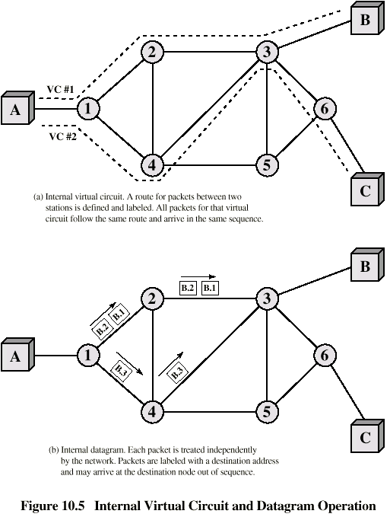
Internal
Virtual
Circuit and
Datagram
Operation
8.<number>

Slide 20
Note
A switch in a datagram network uses a routing table that is based on the destination address.
8.<number>

Slide 21
Note
Switching in the Internet is done by using the datagram approach
to packet switching at
the network layer.
8.<number>

Slide 22
8-3 VIRTUAL-CIRCUIT NETWORKS
A virtual-circuit network is a cross between a circuit-switched network and a datagram network. It has some characteristics of both.
Topics discussed in this section:
Addressing
Three Phases
Efficiency
Delay
Circuit-Switched Technology in WANs
8.<number>

Slide 23

Figure 8.10 Virtual-circuit network
8.<number>

Slide 24

Figure 8.11 Virtual-circuit identifier
8.<number>

Slide 25

Figure 8.12 Switch and tables in a virtual-circuit network
8.<number>

Slide 26

Figure 8.13 Source-to-destination data transfer in a virtual-circuit network
8.<number>

Slide 27

Figure 8.14 Setup request in a virtual-circuit network
8.<number>

Slide 28

Figure 8.15 Setup acknowledgment in a virtual-circuit network
8.<number>

Slide 29
Note
In virtual-circuit switching, all packets belonging to the same source and
destination travel the same path;
but the packets may arrive at the destination with different delays
if resource allocation is on demand.
8.<number>

Slide 30

Figure 8.16 Delay in a virtual-circuit network
8.<number>

Slide 31
Total Delay
Transmission Delay,T
Propagation Delay,P
Total Delay=3T+3P+setup delay+ teardown delay.
Note : ignoring processing time in each switch
8.<number>

Slide 32
Note
Switching at the data link layer in a switched WAN is normally
implemented by using
virtual-circuit techniques.
8.<number>

Slide 33
S(witched)VC vs. P(ermanent)VC setup
A virtual circuit can be either switched or permanent.
If permanent, an outgoing VCI is given to the source,
and an incoming VCI is given to the destination.
The source always uses this VCI to send frames to
this particular destination.
The destination knows that the frame is coming from
that particular source if the frame carries the
corresponding incoming VCI.
If a duplex connection is needed, two virtual circuits
are established.
8.<number>

Slide 34
S(witched)VC vs. P(ermanent)VC setup
A PVC has several drawbacks:
1. Always connected, so always paying
2. Connection is between two parties only. If
you need a connection to another point, you
need another PVC.
Don’t like these disadvantages? Use an SVC.
8.<number>

Slide 35
8-4 STRUCTURE OF A SWITCH
We use switches in circuit-switched and packet-switched networks. In this section, we discuss the structures of the switches used in each type of network.
Topics discussed in this section:
Structure of Circuit Switches
Structure of Packet Switches
8.<number>

Slide 36
Structure of Circuit Switches
Circuit Switching uses either of two technologies
Space-Division Switch
Time-Division Switch
8.<number>
Notes:
Space-Division Switch: paths in the circuit are separated from each other spatially.

Slide 37
Space-Division Switch
single transmission path is accomplished in a switch by using a physically separate set of crosspoints.
Crossbar Switch
Multistage Switch
8.<number>

Slide 38

Figure 8.17 Crossbar switch with three inputs and four outputs
8.<number>
Notes:
N input is connected m output using elctronic micro switches at crosspoint.
Major limitation to add a new port, number of crosspints required is very high.
Adv
Non blocking
At a time only one connection or path is active
N*m crosspints=1000*1000 requires switch with 1000000 crosspint.
Such a switch is inefficient because fewer than 25% of crosspints are in use, at any given time.

Slide 39

Figure 8.18 Multistage switch
8.<number>

Slide 40
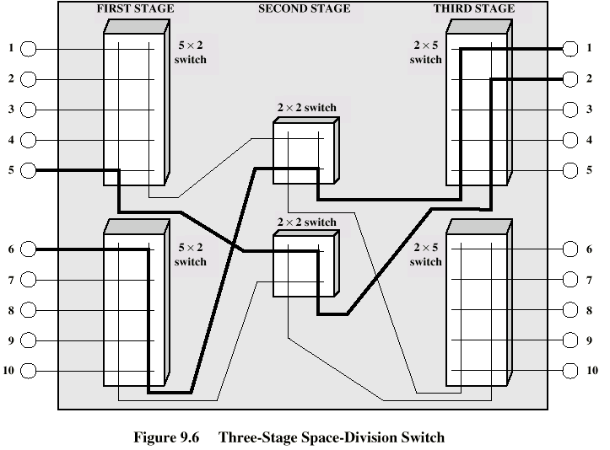
Three Stage Switch
8.<number>

Slide 41

Figure 8.21 Packet switch components
8.<number>

Slide 42

Figure 8.22 Input port
8.<number>

Slide 43

Figure 8.23 Output port
8.<number>

Slide 44

Figure 8.24 A banyan switch
8.<number>

Slide 45

Figure 8.25 Examples of routing in a banyan switch
8.<number>

Slide 46
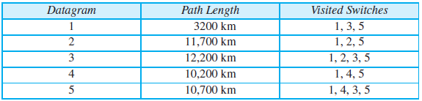
Question
Five equal-size datagrams belonging to the same message leave for the destination one after another. However, they travel through different paths as shown in the table.
We assume that the delay for each switch (including waiting and processing)
is 3, 10, 20, 7, and 20 ms respectively. Assuming that the propagation speed is 2 × 10⁸ m/s, find the order the datagrams arrive at the destination and the delay for each. Ignore any other delays in transmission.
8.<number>
Notes:
1st =59+tfr
2nd =91.5+tfr
3rd=140
4th=81
5th =103.5
Order → 1,4,2,5,3

Slide 47
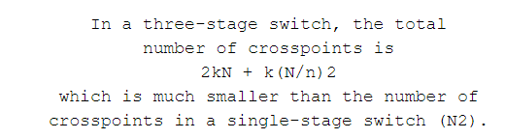
8.<number>

Slide 48
Problems
Design a three-stage, 200 × 200 switch (N = 200) with k = 4 and n = 20.
8.<number>

Slide 49
Problems
Design a three-stage, 200 × 200 switch (N = 200) with k = 4 and n = 20.
Sol. first stage we have N/n or 10 crossbars, each of size 20 × 4. In the second stage, we have
4 crossbars, each of size 10 × 10. In the third stage, we have 10 crossbars, each of size 4 × 20.
8.<number>

Slide 50
Sol conti.
The total number of crosspoints is 2kN + k(N/n)2, or 2000 crosspoints. This is 5 percent of the
number of crosspoints in a single-stage switch (200 × 200 = 40,000).
8.<number>

Slide 51
Drawback
one drawback—blocking during periods of heavy traffic.
Blocking refers to times when one input cannot be connected to an output.
8.<number>
Notes:
Blocking refers to times when one input cannot be connected to an output because there is no path available between
them—all the possible intermediate switches are occupied.
The whole idea of multistage switching is to share the crosspoints in
the middle-stage crossbars. Sharing can cause a lack of availability if the resources are
limited and all users want a connection at the same time

Slide 52
Non Blocking Condition
Clos investigated the condition of nonblocking in multistage switches.
In nonblocking switching fabric, the number of middle-stage switches must be at least 2n – 1.
In other words, we need to have k ≥ 2n – 1.
8.<number>

Slide 53

Clos Criteria
8.<number>

Slide 54
In Summary
What are the differences between a circuit switched network and a packet switched network?
What is a non-blocking switch/network?
What are the differences between datagram packet switched and virtual circuit packet switched?
8.<number>

Slide 55
In Summary
What are the differences between a circuit switch and a packet switch?
8.<number>

